Slide 1
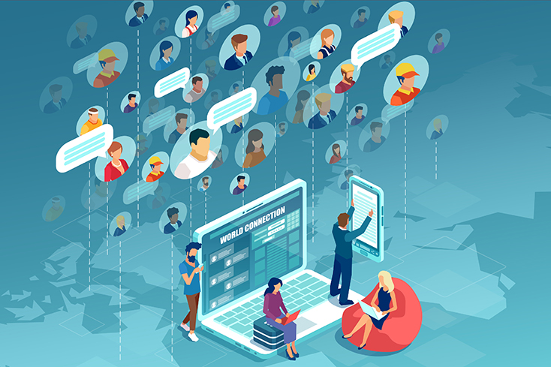
Social Media and Mental Health
Group members:

Slide 2
Contents：
01
03
05
Background information
02
Questionnaire and results
04
Suggestion
A report on the BBC
Analysis of investigation results
Notes:
22d6503c-a7b0-43b0-a9f4-cb495473eb5b.source.5.zh-Hans

Slide 3





What’s Social Media?
Social Media refers to the content production and exchange platform based on user relationships on the Internet. Social media is a tool and platform for people to share their opinions, insights, experience and views with each other, and at this stage it mainly includes WeChat, QQ, Douyin, Weibo, Facebook, Twitter and so on.

Slide 4
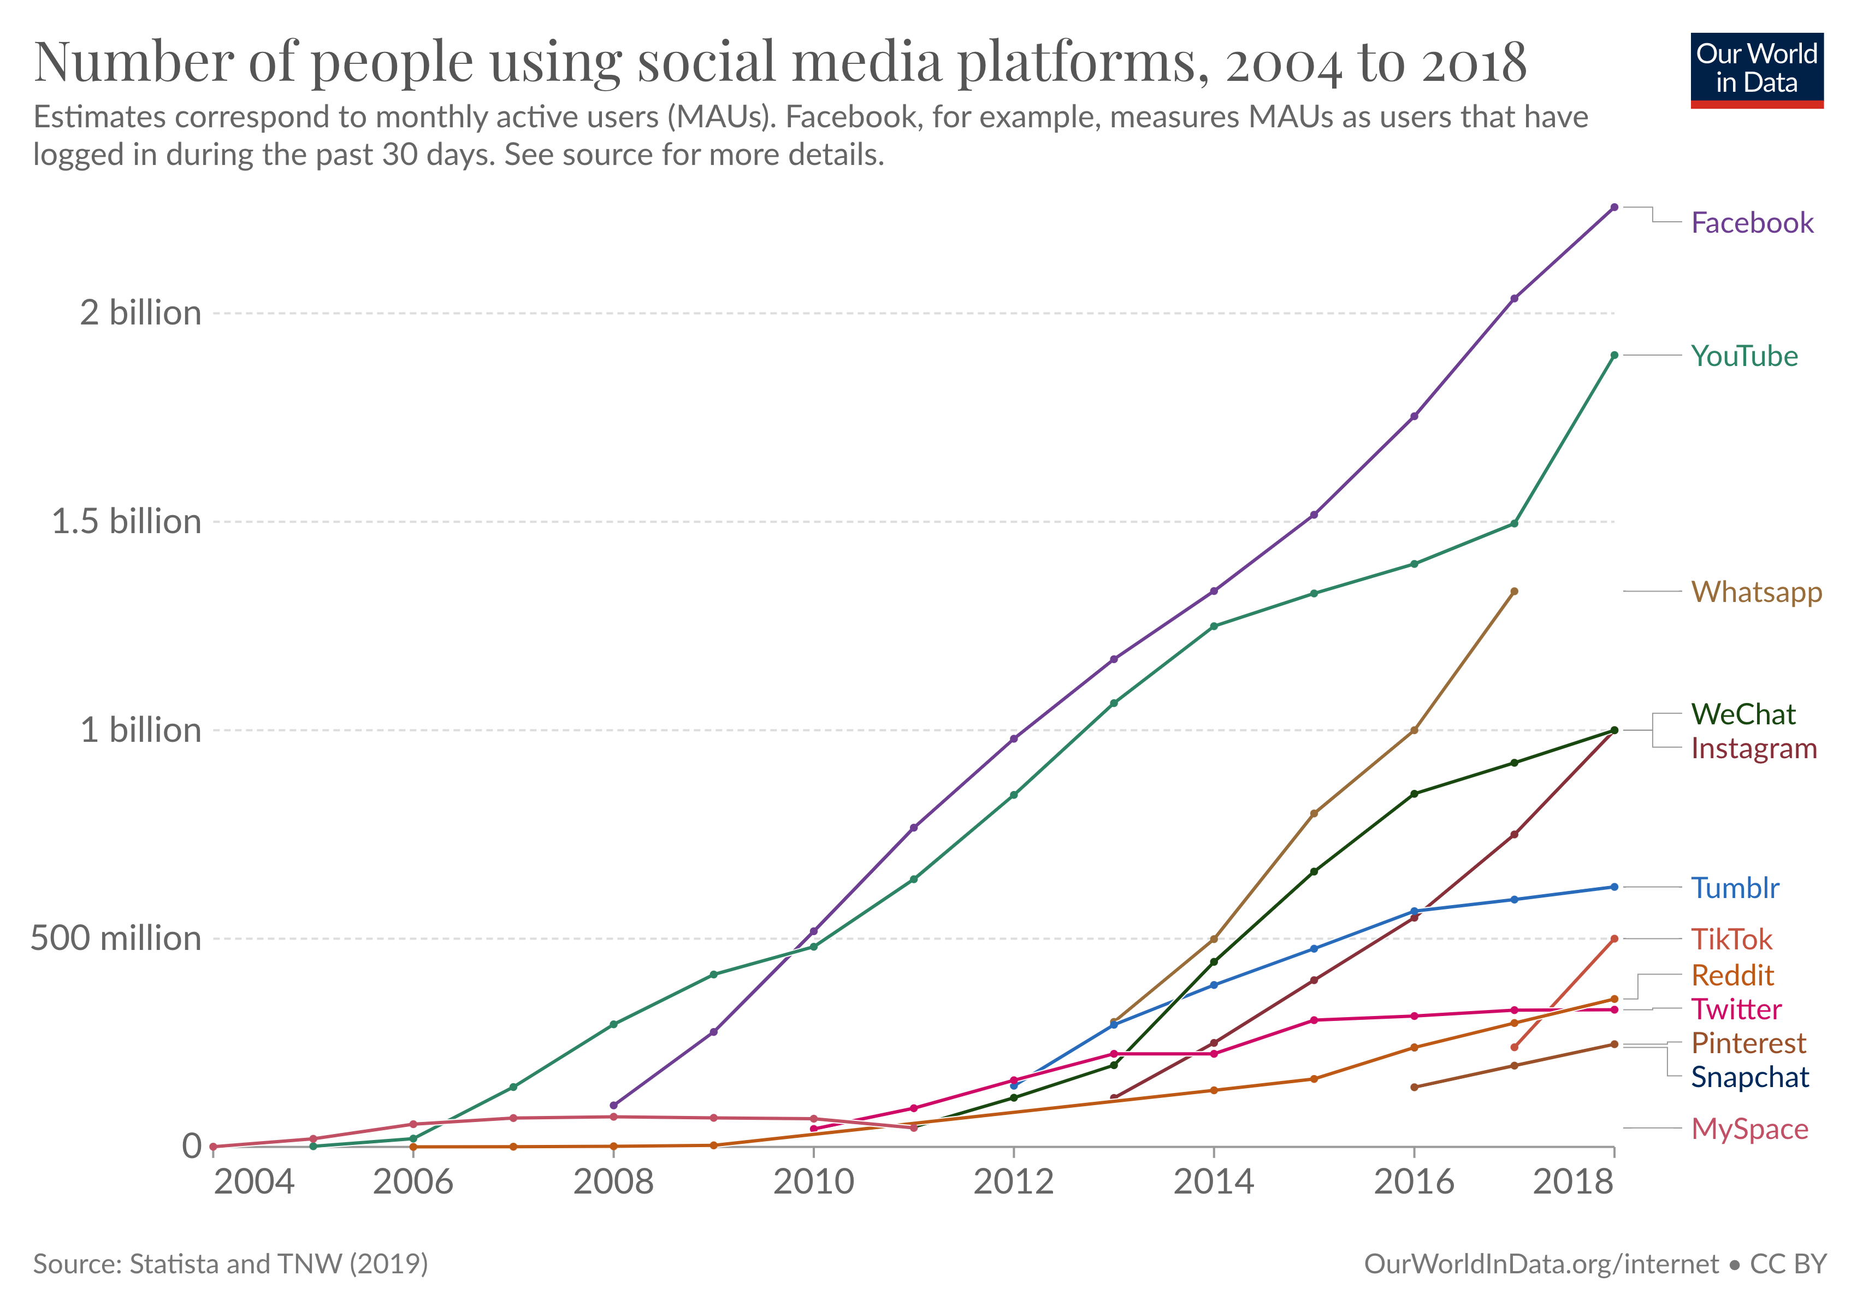
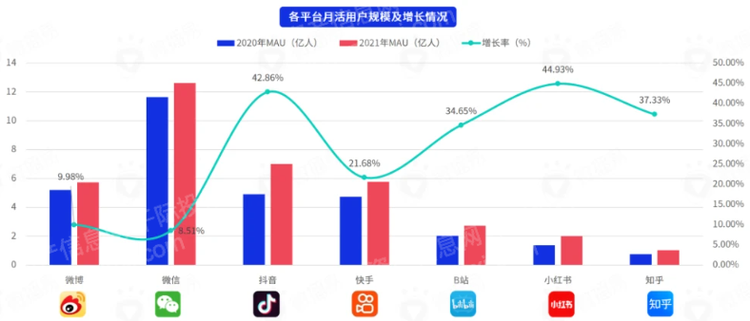
Background information:
Social Media emerged in early 2000s. It has grown very rapidly in recent years. In January 2022, there were already more than 4.62 billion social media users worldwide, equivalent to 58.4% of the total global population. Facebook, the largest social media platform in the world, had 2.4 billion users in 2019. Other social media platforms, including YouTube and WhatsApp, also had over one billion users each. WeChat's users also reached one billion in 2020. Nowadays, with the development of the Internet, social media has become a part of our lives. With this comes unknown good or bad influence.

Slide 5
A report on the BBC:
In early 2018, the BBC website published a report entitled Is social media bad for you? The Evidence and the unknowns. The report opens by suggesting that over 40% of the global population, or nearly three billion people, are now using Internet-based social media. Every day, people spend an average of two hours on social media use. Every minute, more than half a million messages and photos are shared via the social media Twitter and Snapchat. The report analyses the relationship between social media use and people's mental health in more than a dozen ways by integrating multiple global surveys. It mainly includes stress, mood, anxiety, depression, sleep, addiction, self-esteem, envy, loneliness. These indicate that it may be seriously damaging to our mental health.
In view of the above, we made this project.

Slide 6
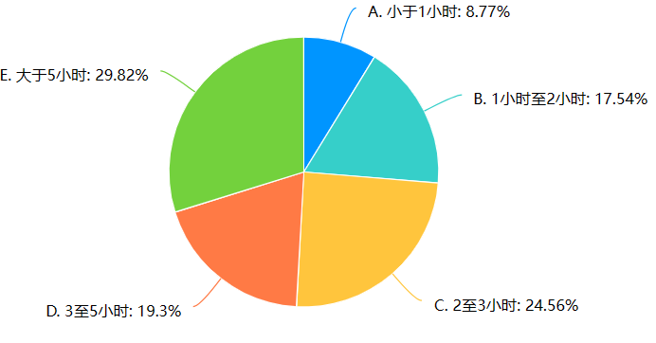
Questionnaire and results:
Six questions have been devised to clarify this issue.
1. How much time do you spend using social media approximately every day?
According to the results of our study, which included five different options, it was found that almost 50% of individuals spend more than three hours each day using social media. This is a considerable amount of time and suggests that individuals should be aware of how much time they are spending on social media and consider implementing strategies to reduce their usage.

Slide 7
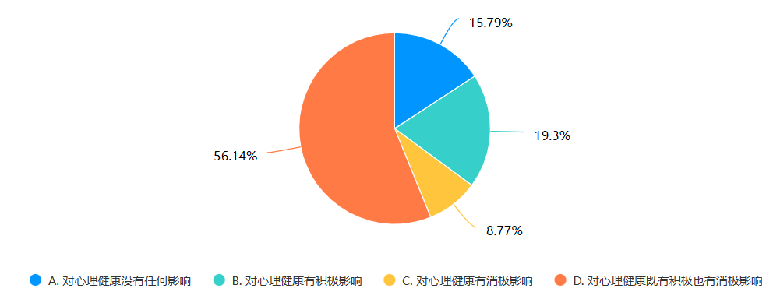
2. How do you think social media has affected your mental health?
According to a recent survey, a majority of people, specifically 56.14%, believe that social media has both positive and negative effects on their mental health. These effects may include increased social connection and access to information, as well as negative impacts such as addiction, anxiety, and depression. However, less than nine percent of respondents believed that social media only has a negative impact on their mental health, suggesting that many people still see potential benefits to using these platforms.

Slide 8
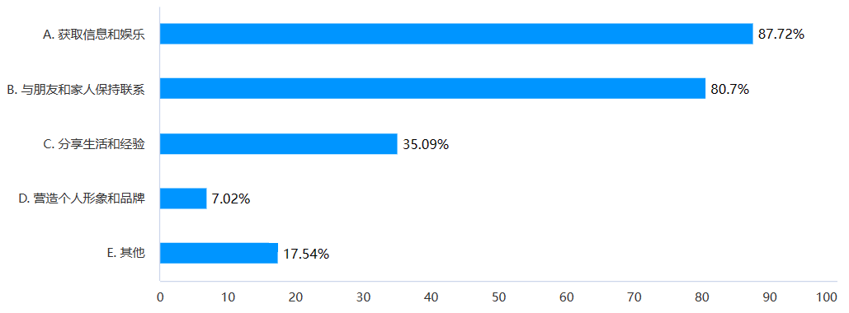
3. What do you use social media for?
The given statement suggests that a vast majority of people utilize social media platforms for a variety of purposes. Specifically, it states that more than eighty percent of individuals use these platforms to gain knowledge and entertainment, as well as to maintain communication with their loved ones. This indicates that social media has become an integral part of modern society, providing people with a convenient and efficient means to access information, keep up with current events, and stay connected with family and friends.

Slide 9
There are two more questions left, we'll pass them on to the next group member.

Slide 10
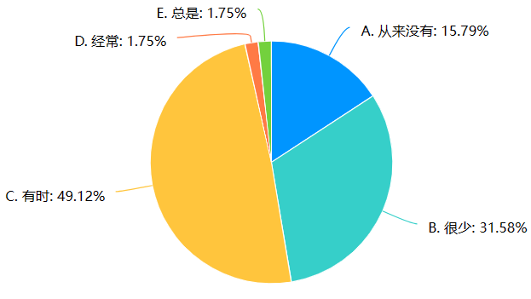
4. Do you feel negative emotions such as anxiety, loneliness or depression when using social media?
The results of a recent study indicate that a large majority of people, over 85%, have experienced negative emotions at some point in their lives. These emotions may include sadness, anger, anxiety, or other unpleasant feelings. Furthermore, almost half of the study participants reported feeling these negative emotions more frequently, suggesting that negative emotions may be a common experience for many people. The study did not delve into the specific causes or triggers of these negative emotions, but suggests that they may be a normal aspect of the human experience.

Slide 11
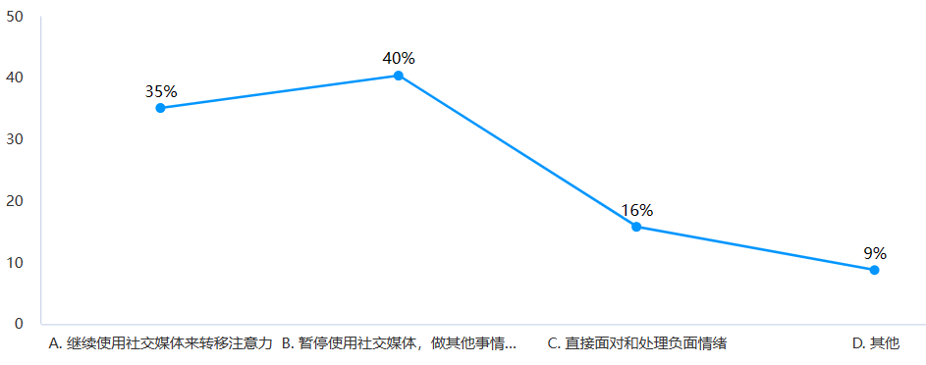
5. What do you do when you feel negative emotions?
According to recent statistics, a significant portion of people have decided to take a break from social media and use their time for other activities. In fact, research shows that as much as 40% of people have chosen to stop using social media altogether. This could be due to a variety of reasons such as a desire to reduce screen time, a need to focus on work or personal goals, or simply a wish to disconnect from the constant barrage of information and notifications. We believe that this decision to take a break from social media can be incredibly beneficial for one's mental health and overall well-being.

Slide 12
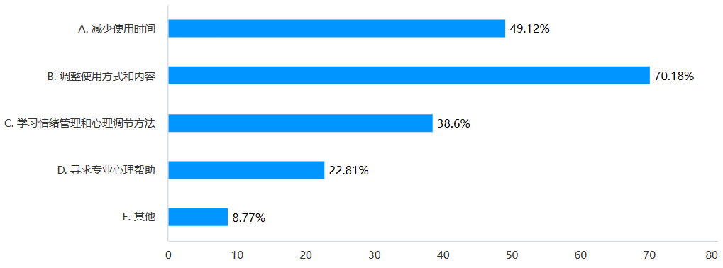
6. How do you think the negative impact of social media on mental health can be reduced?
Reducing time spent is an effective way to increase productivity and achieve a better work-life balance. By analyzing how we spend our time and identifying time-wasting activities, we can eliminate or minimize these activities and allocate more time to tasks that are important and meaningful. This can be accomplished through various strategies, such as setting goals, prioritizing tasks, and implementing time management tools and techniques.

Slide 13
Analysis of investigation results:
From the results of the questionnaire above, it is easy to see that the following problems usually affect our mental health when using social media. Firstly, it is difficult for us to control the amount of time we spend on social media. The longer we use social media, the more likely we are to become addicted to it. Long-term addiction can affect studies and life, and even lead to psychological problems such as depression and anxiety. Secondly, we feel negative emotions when using social media and there are no scientific solutions. With social media filled with perfect pictures and life statuses, it is easy for us to feel a comparative gap between ourselves and others, resulting in social comparison anxiety and feelings of low self-esteem. In most cases, we don't know how to reduce these negative emotions. In addition, bad behavior and comments on social media can also have a negative impact on us. This affects our judgement of value and influence our mental health.

Slide 14
Suggestion:
Social media has its drawbacks, but its strengths cannot be ignored. And it has become an integral part of our daily lives. So it is impossible to remove it from our lives. We should learn how to live with it and use its strengths and discard its weaknesses as much as possible.
1. This requires self-disciplined, which seems difficult to us.
Setting achievable goals is a great way to make progress towards a larger objective. In the case of reducing social media usage, you might start by setting a goal to limit your time on social networking sites to two hours a day for a month. This is a specific and measurable goal that is grounded in reality. It's important to choose a goal that is realistic, as setting an unattainable goal can lead to frustration and disappointment.

Slide 15
2. We should learn to address the negative emotions brought by social media.
Expressing our emotions to people who are close to us can be a great way to feel better. Sometimes just talking about our feelings with someone who listens can provide us with the comfort and support we need. We can share our thoughts and feelings with family members, friends, or even a therapist if we need more professional help.
Also, taking in a beautiful view can also provide us with a sense of peace and calm. Whether it's watching a sunset or gazing at a beautiful landscape, the beauty of the natural world can be a powerful reminder of the goodness and beauty that exists in the world. By taking time to appreciate the beauty around us, we can find hope and solace, even in difficult times.

